Slide 1
Human health-related models in Drosophila
ADRC 2014, San Diego

Slide 2
In this talk….
Why human disease models?
The data so far
Searching human disease model data
What’s next?

Slide 3
Why human disease models?
Dramatic increase in the proportion of Drosophila papers that mention disease over the last 20 years.
1993
1998
2003
2008
2013
Drosophila papers containing “disease” in the abstract or title

Slide 4
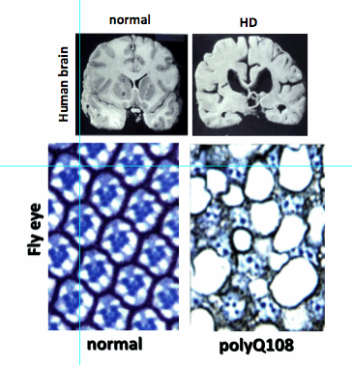
What do we consider to be a disease model?
A genetic model in Drosophila that recapitulates some or all of the phenotypes of a human disease.
Can be either:
Drosophila mutant/transgene
Human transgene in Drosophila
Does not currently include:
Environment, infection or chemical models
Image from http://modencode.sciencemag.org/drosophila/memory2/

Slide 5
The diseases
Alleles have been associated with diseases from the Disease Ontology disease-ontology.org
disease
|__disease of anatomical entity
|__nervous system disease
|__central nervous system disease
|__neurodegenerative disease
|__Parkinson's disease
|__[more ...]

Slide 6
The data
Models
park¹ is a model of Parkinson’s disease
Modifiers of the model
Parkinson’s disease modeled by park¹ is ameliorated by dnk^{Scer\UAS.cLa}
Parkinson’s disease modeled by Pink1^{dsRNA.Scer\UAS} is exacerbated by rictor^{Δ2}
Not a model/modifier
Hsap\PARK2^{G328E.Scer\UAS} does not model Parkinson’s disease

Slide 7
In this release…
>1000 alleles of >500 genes have been associated with >100 diseases described in >400 references.

Slide 8
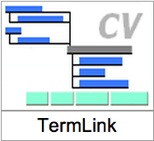
Searching human disease data in FlyBase
If you are interested in a particular disease…….
New “Human Disease” QuickSearch tab
TermLink
If you are interested in a particular gene…….
New section on our gene and allele reports

Slide 9
Searching for alleles associated with a specific disease
1. QuickSearch tab
2. Dedicated CV search tool - TermLink

Slide 10
Searching for alleles associated with a specific disease
Example 1 : Which alleles have been shown to model Parkinson’s disease in flies?

Slide 11
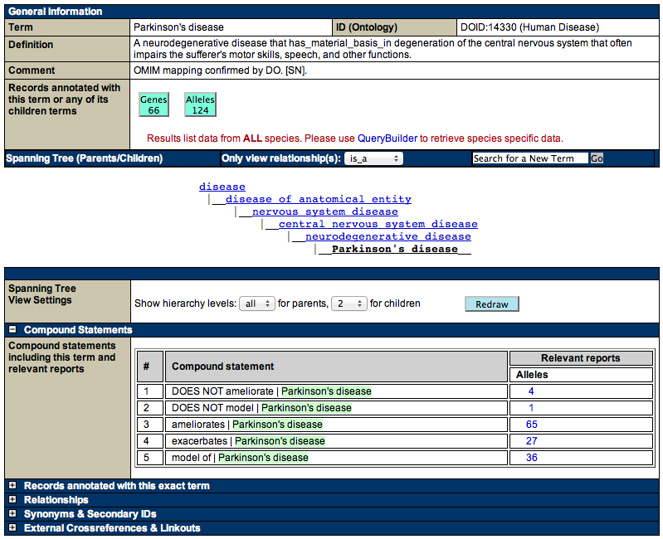
Searching for a specific disease: The disease term report page
Disease details
Links to OMIM

Slide 12
Searching for a specific disease: The disease term report page
Position in Disease Ontology

Slide 13
Searching for a specific disease: The disease term report page
Position in Disease Ontology

Slide 14
Searching for a specific disease: The disease term report page
Links to gene and allele reports

Slide 15
Searching for a specific disease: The disease term report page

Slide 16
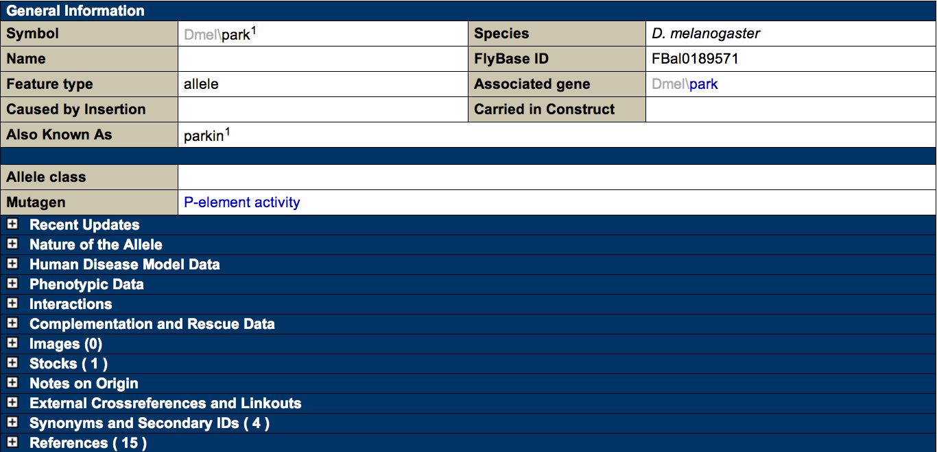
Searching for a specific disease: The allele report

Slide 17
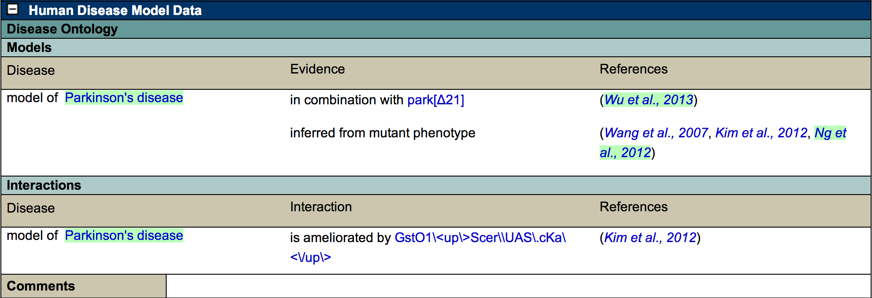
Searching for a specific disease: The allele report

Slide 18
Searching for a specific disease: The allele report

Slide 19
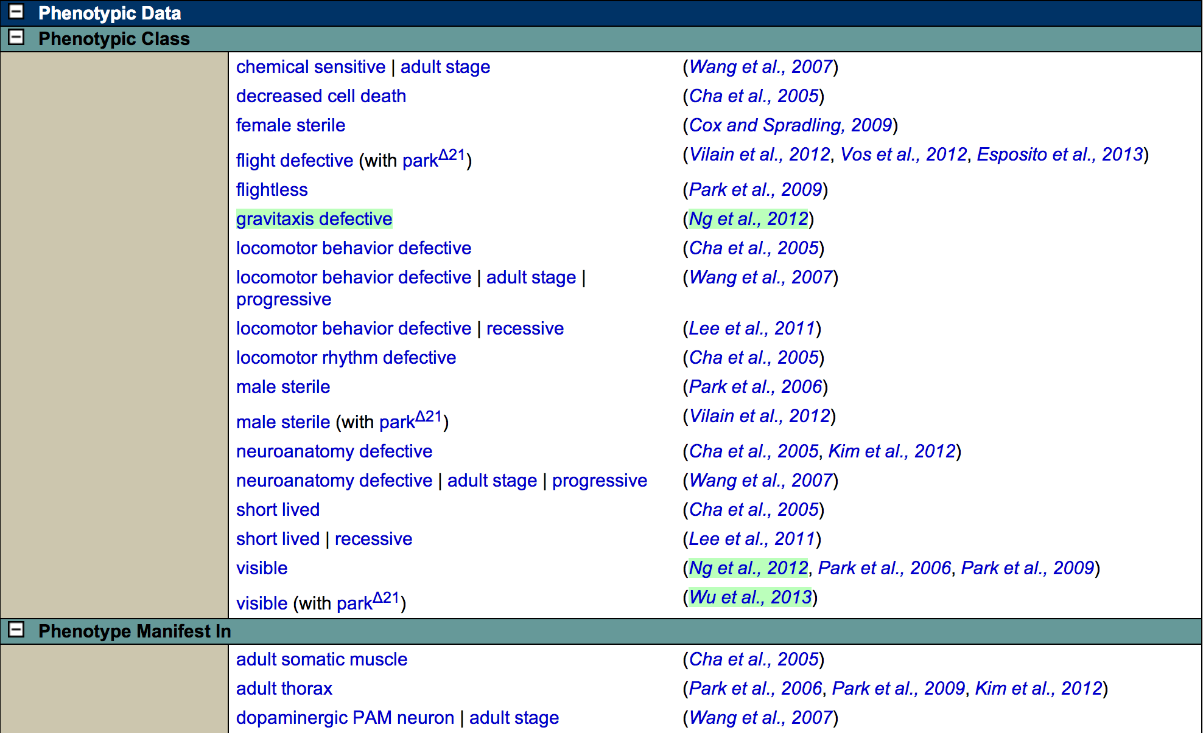
Searching for a specific disease: phenotypes

Slide 20
Searching for a specific gene
Example 2 : Which diseases have been shown to be associated with the Sod gene?

Slide 21
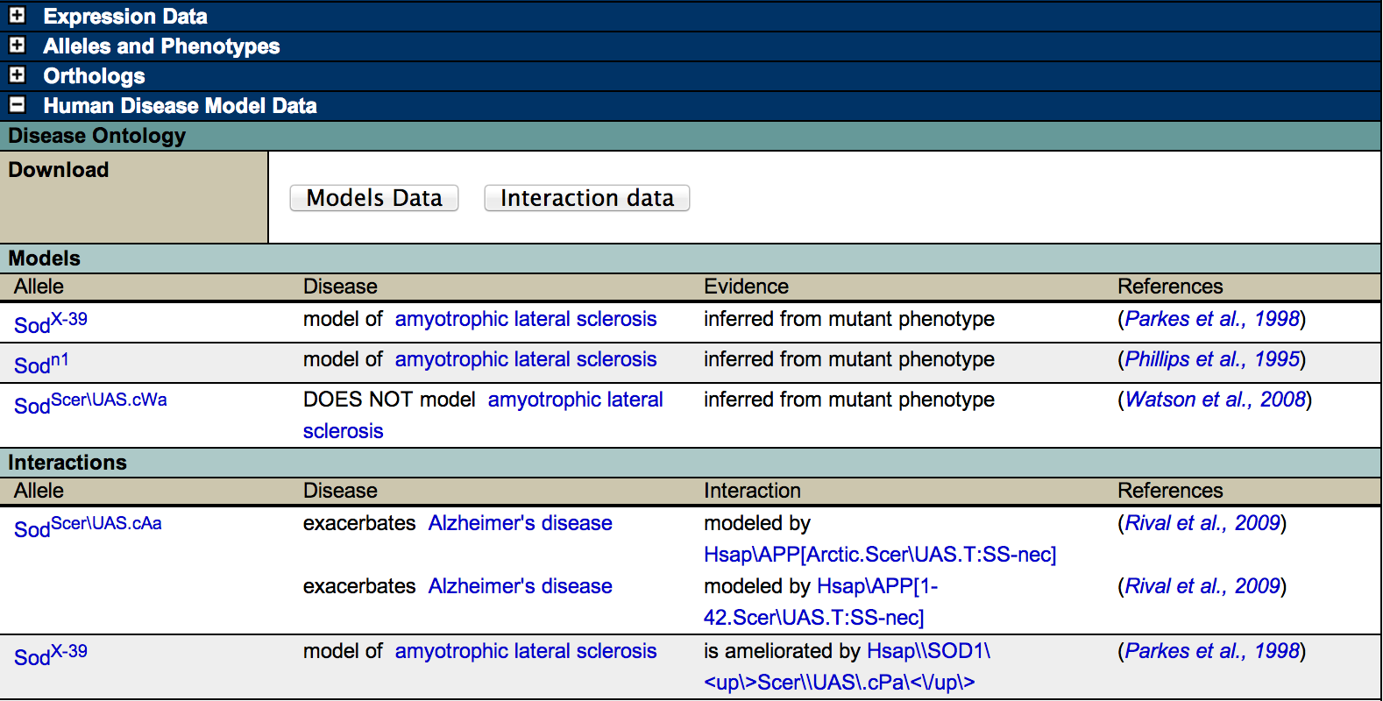
Searching for a specific gene: The gene report

Slide 22
Searching for a specific gene: Orthologs
The Hsap\SOD1 gene report

Slide 23
What’s next?
A precomputed file will be available in the next release (May)
Expand the scope of the data
Tool improvement
Continue to search the literature to improve the dataset

Slide 24
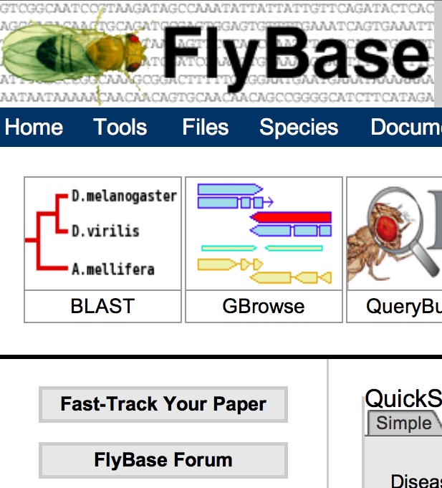
How can you help?
Flag disease models in your new papers using “Fast Track Your Paper”
Are there any key papers we’ve missed?
Feedback on existing features
Suggestions?
Talk to us now, see our poster, or email us

